Slide 1
Welcome to Strathearn Open Morning
Please can you ensure that all mobile phones are on silent.
Notes:
Slide One
Good morning Ladies and Gentlemen, Girls and boys and welcome to Strathearn School, my name is Nicola Connery and I am the Principal of Strathearn School.
I hope that through this short presentation you will find out a lot about Strathearn School however, what I would advise is that you wander around the school asking lots of questions and girls and boys make sure you get to see the great experiments and have a go at lots of our activities on-going in our classrooms.

Slide 2
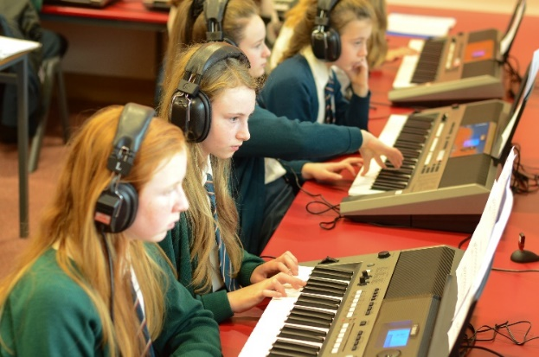
Another school ?
What is Strathearn like?
What is so special about Strathearn?
Why an all girls’ school?
Who goes to Strathearn?

Slide 3
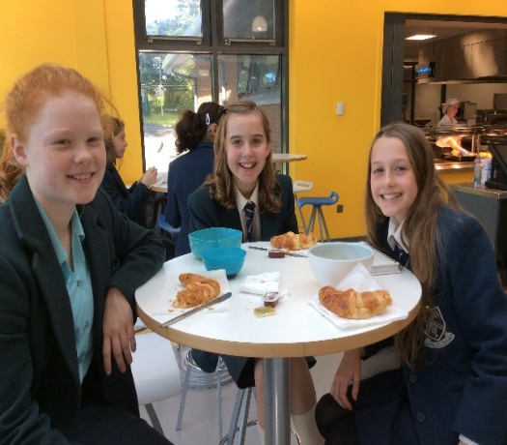
What is Strathearn like ?
Personal
Small classes - Class size 22 in Form 1
Balanced
Academic and extra-curricular
Convenient- walk, car, bus
Newtownards, Bangor, Comber buses to the gate
Contained
Grounds and Sport facilities
Notes:
So what is Strathearn like?
We are personal we have 780 pupils currently enrolled in the School and I like to think that we really get to know them. If you were to choose us then in Form one you would be placed in one of 5 classes of 22 pupils – this makes it really easy for us to get to know you and get to know your individual needs and gives you an opportunity t tell us all about you.!! I do hope that you will find from my presentation and as you wander around the school that this school is all about the girls – our pupils as they are our reason for everything that we do
We encourage a ‘balanced curriculum and we offer a range of subjects some of which may be new to you form Primary School and we continue to offer new subjects offers as the pupils progress up the school and we continually reviewing our subject offer in light of the need so the university's and their application and the labour market requirements. We also believe that our girls should participate in extra curricular activities and we are keen that the girls have a good work life balance and enjoy their time at school. In Strathearn we have a 55 minute lunch break this is facilitate clubs and societies and we have many clubs that are focussed exclusively for our Junior School member that allows them to have the opportunity for leadership roles at an early stage.

Slide 4
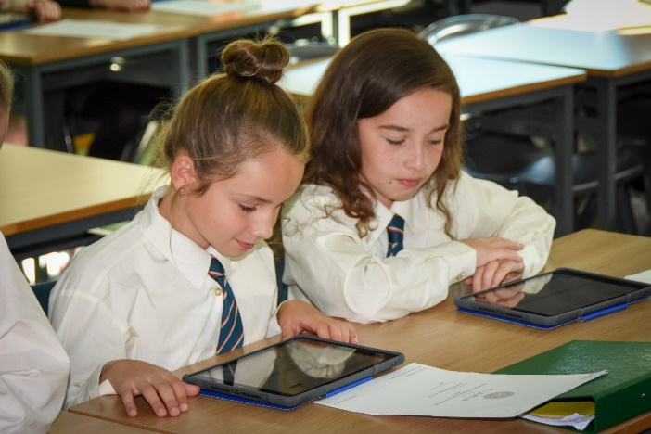
What is so special about us?
(from our pupils)
Quality of Care
Friendships
House System
Small Classes
Opportunities – extra curricular and leadership
Resources – buildings, lockers, i-pads, biometric system
Barbour Boucher McCaughey Watts
Notes:
In Strathearn we pride ourselves in our outstanding pastoral care programme and the quality of care that we give to our pupils. When you start in form One we a carefully planned in induction programme led by our Head of Year and team of tutors in which we cover all aspects of everything you would need when settling in with us. As I have already mentioned we are very keen to allow our pupils to undertake roles that allows them to assume responsibility – such as forma captains members of our school council and junior librarians. However anything we do is always carefully supported by my pastoral care team who include form tutor, head of Year, school nurses a school councellor and by VP pastoral

Slide 5
What is so special about us?
Head Girl
Ella Reid
Notes:
But I would now like to invite our Head Girl to speak and let you know from her perspective – what is so special about us? Rachel has attended Strthearn for 6. 5 years and will give you her perspective - Rachel

Slide 6
What is so special about us?
Quality of Pupil Achievements
the girls find the work challenging – satisfaction - ‘Can do’
Opportunity
Success
Notes:
Thank you Rachel and Rachel epitomises the girls she represents in the school and I would ask that as you walk around this morning ask our girls what makes this school special to them? Now of course we are here to educate our daughters and the quality of pupil achievements in this school is exceptional – we do challenge our girls to work hard and be the best that can do – from day one we make no apologies for instilling within them a ‘can do approach’ to their studies. We also find that they drive each other forward as they talk to each other and discuss their work. We offer a great range of subjects that allows them to diversify into whatever area of academic study they choose so that they can excel.

Slide 7
What is so special about us?
2017 Achievements
At A Level
1st in NI in A level HE & French
79.25% achieved 3 A*-C
At GCSE Level
67 % grades A or A* (NI girls in Grammar 53.9%)
1st in NI in Business Studies; 2nd in ICT*; 3rd in Mathematics
4 pupils achieved full marks in GCSE ART
* ICT- Short Course
Notes:
We excel in our educational outcomes and have an excellent success rate in external examinations, details of all of our examination results for the past year can be found in your prospectus. My presentation will aso e on the school Website on Monday. 29 girls got 3A’s or better in their A levels last year.

Slide 8
Rank 2016 | Rank 2017 |  |  | A level % A* -B | GCSE % A* - A
53 | 22 | Lumen Christie | L’Derry | 88.1 | 71.4
44 | 29 | Our lady & St. Pat’s | Belfast | 83.6 | 72.1
79= | 33 | Friends’ School | Lisburn | 80.3 | 69.5
60 | 39 | Strathearn School | Belfast | 79.7 | 67.9
57 | 40 | Rainey Endowed | Magherafelt | 83.5 | 61.6
38= | 41 | Rathmore Grammar | Belfast | 84.0 | 60.4
61 | 51 | St Mary's Grammar | Magherafelt | 80.5 | 63.5
87 | 57= | Dalriada School | Ballymoney | 77.1 | 61.9
 | 70= | St. Louis Grammar | Ballymena | 77.8 | 60.0
 | 81= | Methodist College | Belfast | 76.3 | 57.8
97 | 120 | Aquinas | Belfast | 77.1 | 55.8
Notes:
We also add our information into the National table of results for the UK as a produced by The Sunday times and we have consistently held out position in this over the past few years

Slide 9
Pupil Success – Sport
Pupils are successful at Ulster, Irish and UK level
Notes:
Another strength in the school is our music department and we would ask you to call in this morning and see the wonderful facilities they have and I believe their them in the room this morning is learn to play the ukulele.

Slide 10
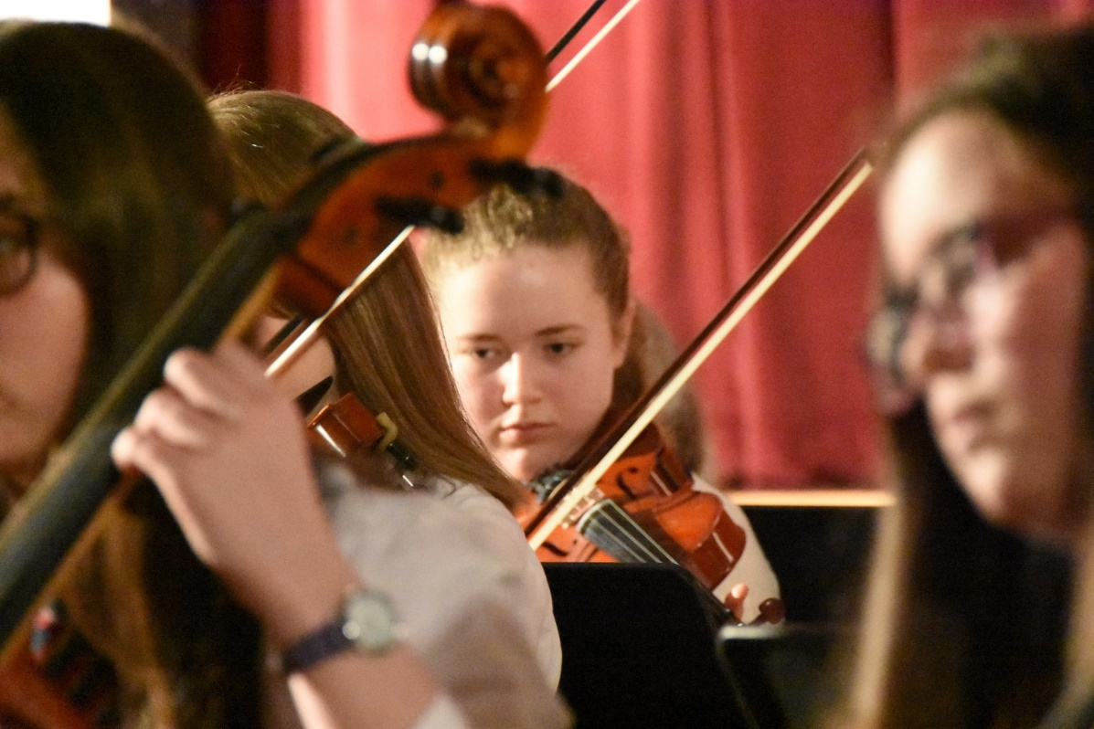
Pupil Success – Music
Pupils perform at many school events and enter competitions.
Notes:
Another strength in the school is our music department and we would ask you to call in this morning and see the wonderful facilities they have and I believe their them in the room this morning is learn to play the ukulele.

Slide 11
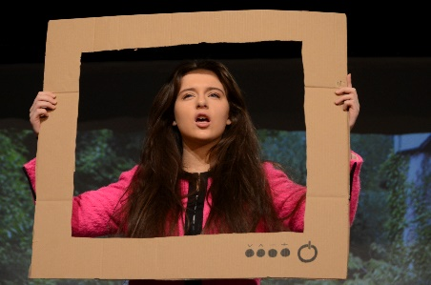
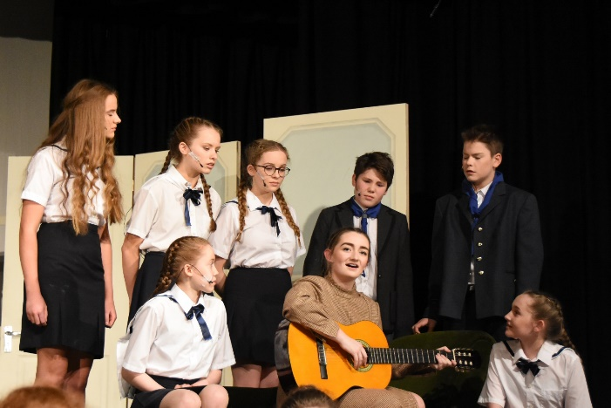
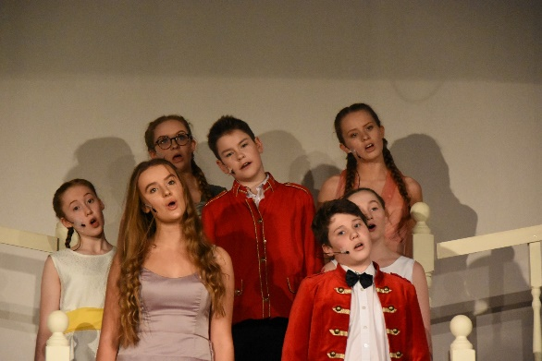
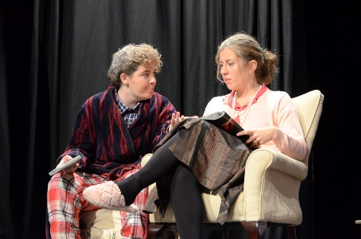
Pupil Success– Drama
Dec. 2017 ‘The Sound of Music’
Oct. 2017 House Play Competition (each October)
Mar. 2017 Evening of musical theatre with Campbell College
Notes:
Drama – the girls in the school get involved at dram a from a very early stage and we find that is very good for both vertical and horizontal integration of year groups. We have annual house palsya dn school productions and our senior production is often linked with Campbell College.

Slide 12
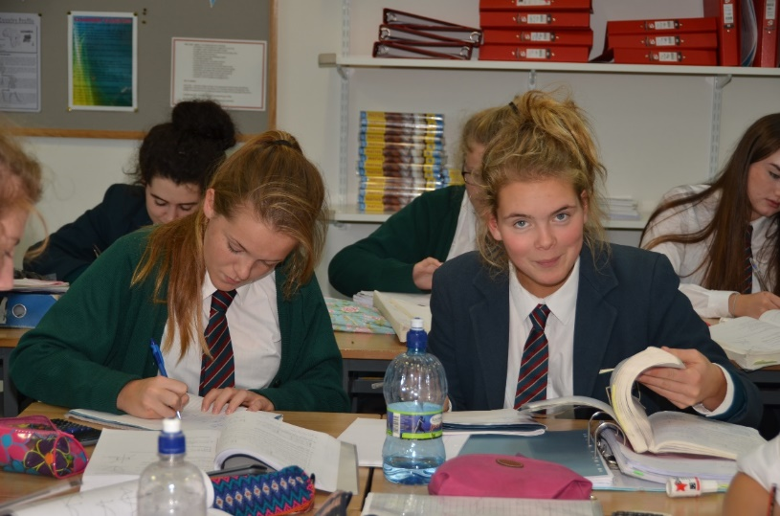
Why an all girls’ school?
Personal development
Academic
development
Notes:
Why all girls ? For the personal development we feel that it allows them to stay focussed with and builds their confidence – in an all girls environment we find that girls can excel in any areas of their personal choice– our top subject for pupil numbers within the school is in the STEM subjects and we feel that girls can thrive at their own choice.
Girls can

Slide 13
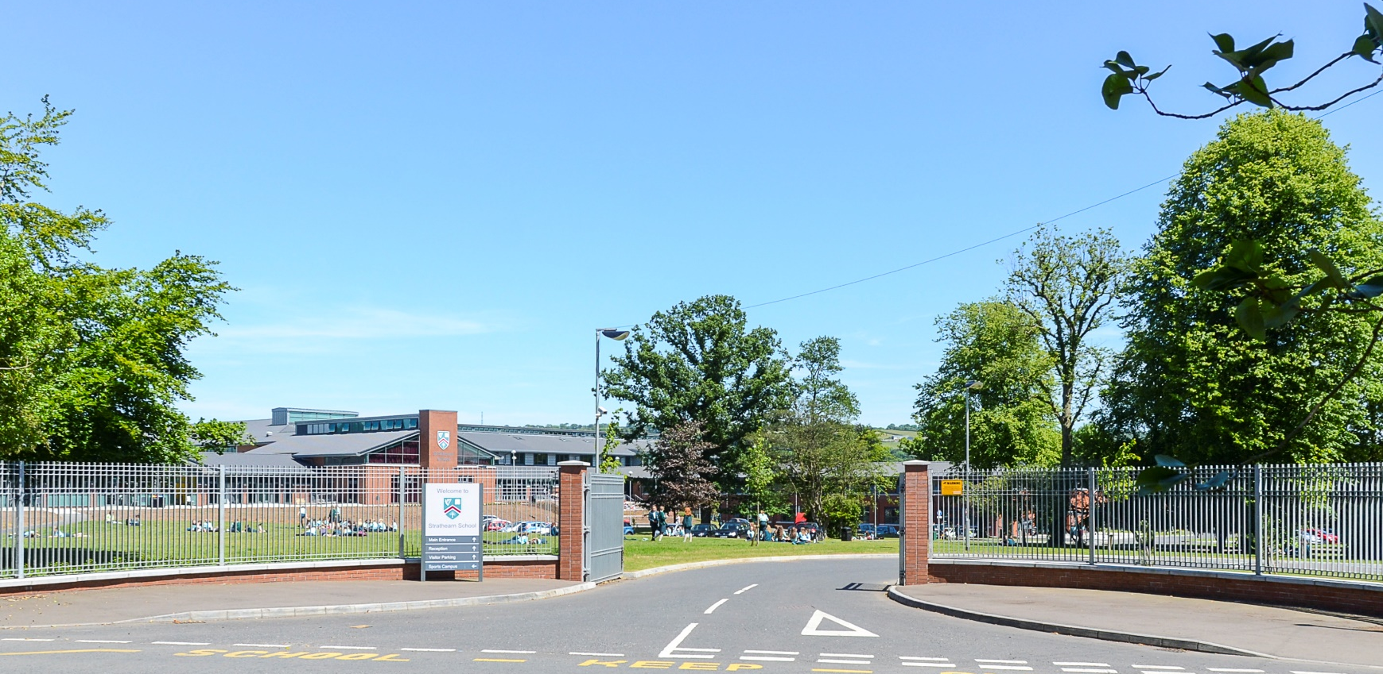
Who comes to Strathearn?

Slide 14
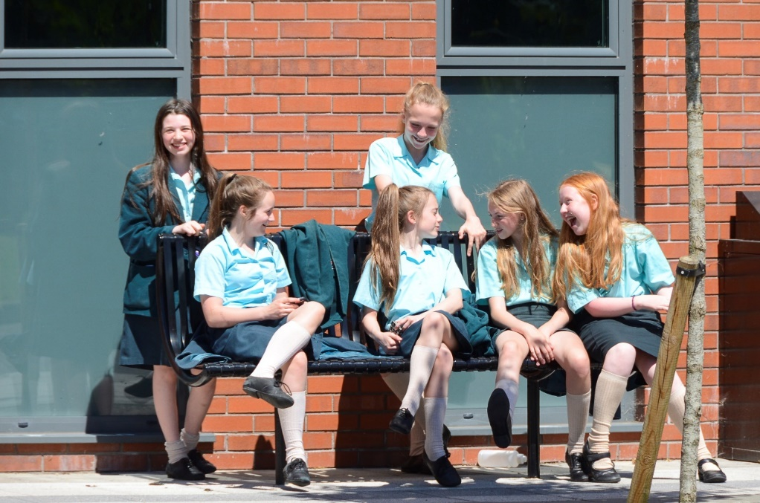
Who comes to Strathearn?
110 places just for girls
Very wide catchment area
Notes:
We have been allocated by DE 110 places for our Form one classes – we have a catchment area that extends into North Down into the peninsula and up to north Belfast and out to carrickfergus!! We have currently 22 feeder primary schools for Strathearn

Slide 15
Admissions patterns
Year | Admissions Number | Total Applications | Total Admissions | Lowest score
Sept 14 | 110 | 177 | 110 | 98
Sept 15 | 110 | 191 | 110 | 104
Sept 16 | 110 | 154 | 110 | 102
Sept 17 | 110 | 125 | 110 | 96
Sept. 2016 - applicants accepted | September 2016 | September 2017
All applicants with scores between | 106 and 125 | 103 and 125
Applicants from the ‘pool’ | Nine: 102 – 105 | Nine: 96 – 102
Notes:
As you can see the intake scores are all on the right hand side of the screen and we have moved between 95 and 104

Slide 16
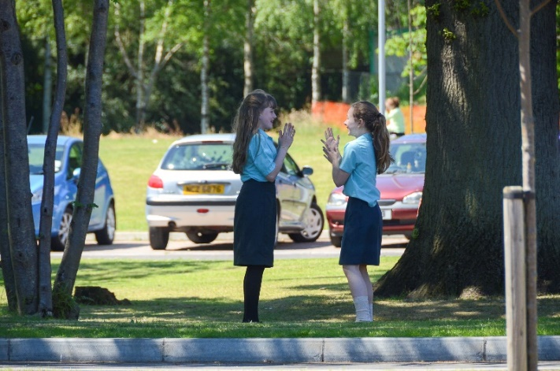
Admissions patterns
1. The first 100 places (out of 110) offered to those with highest score.
2. From the next 15 pupils – 10 offered a place based on ….
Pupils in Prep. Dept
Sister currently enrolled Eldest eligible
Score
FSME
Sister formerly at Strathearn
Brother at Inst or Campbell or
Parent an employee or
Daughter of former pupil
Proximity to home
Notes:
We take the first 100 pupils from those with the highest AQE score . We the create a pool of at least fifteen pupils identifies on the criteria on the screen - basis of the family connections criteria first of all but every year to date the pool has extend down to take account of eldest eligible and distance from school.

Slide 17
Admissions patterns
Year | Admissions Number | Total Applications | Total Admissions | Lowest score
Sept 14 | 110 | 177 | 110 | 98
Sept 15 | 110 | 191 | 110 | 104
Sept 16 | 110 | 154 | 110 | 102
Sept 17 | 110 | 125 | 110 | 96
Sept. 2016 - applicants accepted | September 2016 | September 2017
All applicants with scores between | 106 and 125 | 103 and 125
Applicants from the ‘pool’ | Nine: 102 – 105 | Nine: 96 – 102
Notes:
As you can see the intake scores are all on the right hand side of the screen and we have moved between 95 and 104

Slide 18
Best wishes to all our visitors

Slide 19
Tours – Organised by Deputy Head Girls
Katy Shannon
Notes:
Now you will glad to know that I coming to the end and we hope that you will enjoy a tour of the school we have some guides waiting outside or we have senior girls positioned around the school – Please feel free to ask as many questions as you wish and Rachel and I will be here to take questions if you need us to – so a final welcome to Strathearn school and we really hope you enjoy your time with us.

