Slide 1


Strathearn School
Belfast
L6 Information Evening
2022

Slide 2
PROGRAMME FOR THE EVENING
Welcome Mrs Connery (Principal)
Curriculum Mr Anderson (VP)
Pastoral Mrs Ingram (Head of Lower Sixth)
Careers Ms Griffith (Head of Careers)
Conclusion Mr Anderson (VP)
2

Slide 3
AIMS OF L6 INFORMATION EVENING
To give parents an understanding of the 6th form experience
To help parents offer practical support to their daughters
To strengthen the home school partnership
3

Slide 4
COVID-19 Mitigations for Summer 2023
Advanced Information
Subject specific detail to follow from CCEA in Term 2
Full specifications to be delivered and assessed
4

Slide 5
The differences
Forms 4 & 5 | Form 6
9 GCSEs All timetabled Directed study Homework | 4 / 3 AS Levels & 3 A2 Careers classes 75% timetabled Independent Study Supervised Study Homework Privileges Common room Lunch time
5

Slide 6
Subject Choices
Lots of changes over the last couple of weeks
Make sure have researched carefully the implications for any career aspirations
Check with the Careers Department
3 v 4 AS Levels

Slide 7
AS and A Level Courses
CCEA EXAM Board
AS is 40% of A Level
AQA Board Specification: Media Studies
No AS Examination
EDEXCEL Board Specification: Drama
No AS Examination

Slide 8
Collaboration
A small number of courses are run in collaboration with our partner school:
  Campbell College
Additional Challenges
Different school calendars

Slide 9
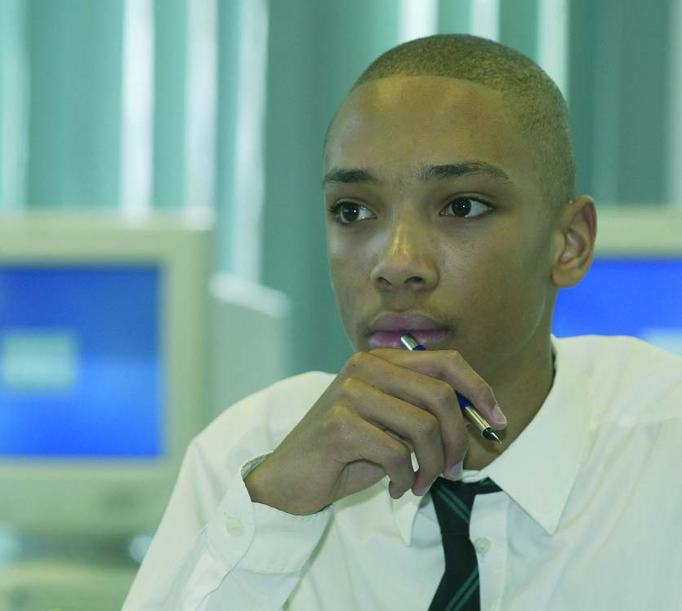
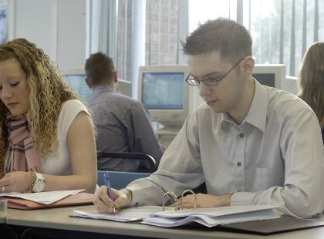
Coursework Guides
For pupils
For parents
Authenticating coursework
www.ccea.org.uk
Coursework - A guide for parents
www.jcq.org.uk
9

Slide 10
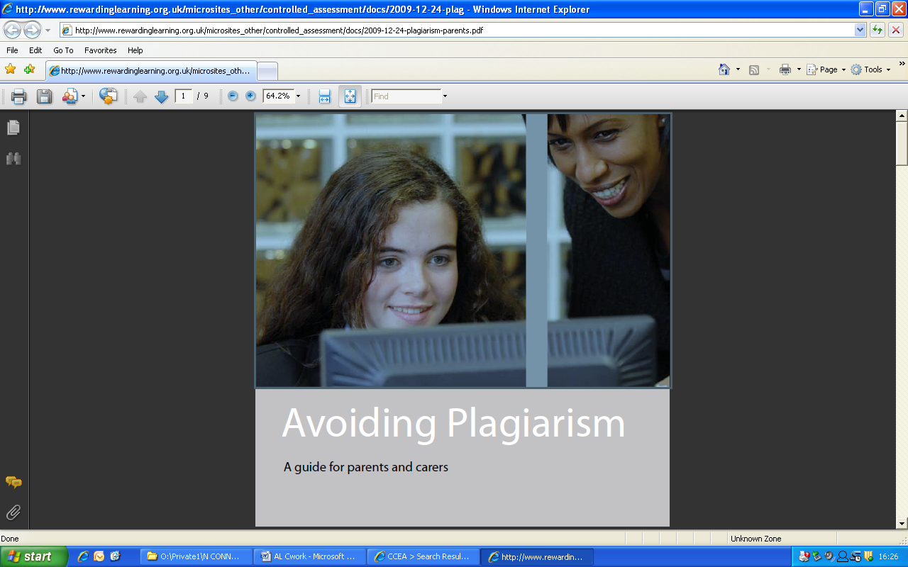
www.ccea.og.uk
10

Slide 11
Pastoral
Mrs Ingram
(Head of Lower Sixth)
11
Notes:
Welcome parents, my name is Debbie Ingram and I will be Head of Year for your girls for the next two years.

Slide 12
Support for Girls:
Form tutors
Head of Sixth Form
  supportive role
  pastoral and academic
Personal study support – Ms Stevenson
Learning support – Mrs Sinnerton / Ms Young
Careers staff
Vice Principal (Pastoral) – Mrs Sinnerton
12
Notes:
I thought it might be helpful to outline the pastoral structure here at Strathearn.
Day to day support comes from the girls form tutors - who they see every morning and once a week for LLW. They are the first port of call for the pupils for most pastoral issues.
Then there is me – my role is to support the Tutors and of course you and your daughters. Please feel free to contact me about any concerning issues you have regarding your daughter’s pastoral and academic well being.
Ms Stevenson offers Study support during the girls Personal Study time and each form class has a dedicated Careers period each week with a Careers teacher.
Our Vice Principal for Pastoral care is Mrs Sinnerton.

Slide 13
BEING IN SIXTH FORM
Privileges and opportunities:
    ‘Study’ periods
    Relationship with teachers
    Timetable flexibility
13
Notes:
Obviously there have been a number of changes in school and we are all adjusting to the new normal, but I think its important to focus on the positive and highlight some of the opportunities for our L6 pupils.
They how have study periods on their timetable allowing them to manage their workload as they adjust to A level study
They will notice subjects teachers at A level assume a level of maturity and independence in their students.
Finally, students are allowed attend with a greater degree of flexibility as they do not have to come to school until their first teaching period of that day and can leave after their last.
I hope they enjoy these new found privileges

Slide 14
Responsibilities
Attendance and punctuality (monitored and reported)
Use of personal study time in school (crucial for success!)
Management of deadlines
Role models for younger girls
The Sixth Form Agreement
The Sixth Form Study Agreement
14
Notes:
With more privilege comes more responsibility!
Our 6th year pupils are role models for the younger year groups!
Therefore, Its is key that all students attend school regularly and are punctual in their time keeping. This will help them manage workload and deadlines successfully.
Details of these are set out in the 6th form agreements that the girls have already signed.

Slide 15
HOW TO SUCCEED
Good attendance and punctuality
Personal discipline and good organisation
Proactive approach
Watch for early warning signs
15
Notes:
Pupils will adjust to A Level study if they manage from outset
Good attendance, good organisation and take a Proactive approach to their studies
If a student feels they are falling behind or aren’t coping, we are here to support them and early intervention is always best.

Slide 16
EARLY WARNING SIGNS
‘Coasting’
Missed deadlines
Disappointing marks
Loss of control
16
Notes:
Finally, a few pointers that will help parents and students understand if they are not coping with Sixth year life.
We are looking sat these issues along with a Time Management Unit in LLW over the coming weeks - hopefully the girls will gain some valuable tools from this.
However, If a student feels they are falling behind or aren’t coping, we are here to support them - early intervention is always best so please encourage them to talk to us if they feel like this is happening.
I look forward to hopefully seeing you all face to face in this not too distant future.

Slide 17
SIXTH FORM CAREERS PROGRAMME
Miss Griffith
Head of Careers

Slide 18
CAREERS CLASSES IN 6TH FORM
1 period per week
2 main areas of study:
Preparation for the world of work
Options at 18+

Slide 19
PREPARATION FOR WORLD OF WORK
Job advertisements
CV preparation
Completing an application form
Labour Market Information
Introduction to interview skills (mainly in U6th)
Work experience

Slide 20
Term 2, 3 & the June Programme
Personal Statement, UCAS and other post-18 research.
19th – 23rd June 2023: 5 day work placement,
14th - 16th June and 26th & 27th June 2023: Preparation for Work Experience, Work Experience report, Personal Statement, Post-18 research.

Slide 21
OPTIONS AT 18+
Further education
Direct employment
Gap year
Higher education

Slide 22
HIGHER EDUCATION PREPARATION
Guest Speakers
Talks and courses by professional organisations
Insight days

Slide 23
CHOOSING UNIVERSITIES
Pupils are encouraged to make use of:
University speakers & Road Show
Past pupils
Open Days visits to local universities
Visits to other Open/Info days
H E Convention & Oxbridge Student Conference
Prospectuses,
DVDs, CD Roms
Websites - especially
www.ucas.com
www.russellgroup.ac.uk
Careers Library

Slide 24
AIMS FOR SEPT 2022 - AUG 2023
By the end of L6:
Each pupil should have:
A list of 6 – 10 possible courses
A Personal Statement
Researched a range of post-18 options
During the Summer Holidays:
Pupils should:
Discuss options with parents.
Research and, if possible visit, universities where courses of interest to them are offered

Slide 25
And finally
Use the facilities in the Careers Suite
Join all relevant Career Teams
Attend lunchtime talks
Check Careers Calendar regularly which is on the school website
Check Useful Websites section – also on school website
25

Slide 26
Concluding Remarks
Mrs Connery

